Slide 1

INSTITUTE - UIE
DEPARTMENT- ACADEMIC UNIT-2
Bachelor of Engineering (Computer Science & Engineering)
Subject Name: Object Oriented Programming using C++
Subject Code:20CST151
Unit-2
Topic : Polymorphism
DISCOVER . LEARN . EMPOWER

Slide 2


Object Oriented Programming using C++
Course Objectives
To enable the students to understand various stages and constructs of C++ programming language and relate them to engineering programming problems.
To improve their ability to analyze and address variety of problems in programming domains.

Slide 3



Course Outcomes
CO Number | Title | Level
CO1 | Provide the environment that allows students to understand object-oriented programming Concepts | Understand
CO2 | Demonstrate basic experimental skills for differentiating between object-oriented and procedural programming paradigms and the advantages of object-oriented programs. | Remember
CO3 | Demonstrate their coding skill on complex programming concepts and use it for generating solutions for engineering and mathematical problems. | Understand
CO4 | Develop skills to understand the application of classes, objects, constructors, destructors, inheritance, operator overloading and polymorphism, pointers, virtual functions, exception handling, file operations and handling. | Understand

Slide 4
Scheme of Evaluation
Sr. No. | Type of Assessment Task | Weightage of actual conduct | Frequency of Task | Final Weightage in Internal Assessment (Prorated Marks) | Remarks
1. | Assignment* | 10 marks of each assignment | One Per Unit | 10 marks | As applicable to course types depicted above.
2. | Time Bound Surprise Test | 12 marks for each test | One per Unit | 4 marks | As applicable to course types depicted above.
3. | Quiz | 4 marks of each quiz | 2 per Unit | 4marks | As applicable to course types depicted above.
4. | Mid-Semester Test** | 20 marks for one MST. | 2 per semester | 20 marks | As applicable to course types depicted above.
5. | Presentation*** |  |  | Non Graded: Engagement Task | Only for Self Study MNGCourses.
6. | Homework | NA | One per lecture topic (of 2 questions) | Non-Graded: Engagement Task | As applicable to course types depicted above.
7. | Discussion Forum | NA | One per Chapter | Non Graded: Engagement Task | As applicable to course types depicted above.
8. | Attendance and Engagement Score on BB | NA | NA | 2 marks

Slide 5
CONTENTS
Operator overloading,
Rules for overloading operators,
Overloading of unary & binary operators,
The word polymorphism means having many forms.
In simple words, we can define polymorphism as the ability of a message to be displayed in more than one form.

Slide 6
OPERATOR OVERLOADING
AIM-
To enable C++ operators to work with objects of class. i.e. In order to use an operator on a class object, it must be overloaded.
The jobs performed by overloaded operators can also be performed by explicit function calls, but the operator notation is more clearer and more familiar to the programmer.
Operator overloading is an important concept in C++. It is a type of polymorphism in which an operator is overloaded to give user defined meaning to it. Overloaded operator is used to perform operation on user-defined data type.
For example '+' operator can be overloaded to perform addition on various data types, like for Integer, String(concatenation) etc.
Normally, arithmetic operators works only on int, float, double and long values. If arithmetic operators are used with user- defined datatypes, it will generate an error. But if the operator is overloaded, the corresponding method is called automatically.

Slide 7
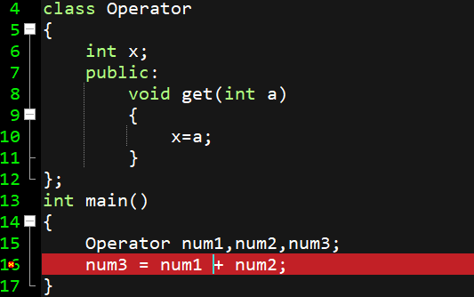

OPERATOR OVERLOADING- WHY?
Figure 5.21 Program made on Dev C++

Slide 8
POINTS TO BE NOTED
New operators cannot be defined.
Meaning of operators cannot be changed.
The function through which operator overloading is achieved must be either non-static member function or a global function which is friend function.
We can overload unary operators, binary operators but not ternary operator.

Slide 9
HOW TO OVERLOAD? USE OPERATOR FUNCTION
In C++, you can overload most operators so that they perform special operations relative to classes that you create.
Operator Overloading is achieved by creating ‘Operator Function’ using the keyword “operator”.
An operator function defines the operations that the overloaded operator will perform relative to the class upon which it will work.
Operator functions can be either members or non-members of a class.
Non-member operator functions are almost always friend functions of the class.
The way that operator functions are written differs between member and non-member functions.
Overloading as Member Function:
When you are overloading a unary operator, argument list will be empty.
When you are overloading binary operators, argument list will contain one parameter.
Overloading as Friend(global) Function:
Unary operators take one argument.
Binary operators take two arguments.

Slide 10
OPERATOR THAT CAN’T BE OVERLOADED
Friend Functions cannot be used to overload the following operators (however, member functions can be used):
= Assignment Operator
( ) Function Call Operator
[ ] Subscript Operator
-> Arrow Operator
Operators that cannot be overloaded
SCOPE RESOLUTION operator ::
sizeof
typeid (to know the type of an object)
member selector .
member pointer selector .*
ternary operator ?:

Slide 11
OVERLOADING UNARY OPERATOR
SYNTAX (using member function):
return_type operator op ( )
example:
void operator ++ ( ){
a= ++a;
b= ++b;
}
void operator -- ( ) {
a= --a;
b= --b;
}
Creating
Operator
function
Keyword
Operator to be
overloaded
Notes:
// C++ program to explain
// Single inheritance
#include <iostream>
using namespace std;
// base class
class Vehicle {
public:
Vehicle()
{
cout << "This is a Vehicle" << endl;
}
};
// sub class derived from two base classes
class Car: public Vehicle{
};
// main function
int main()
{
// creating object of sub class will
// invoke the constructor of base classes
Car obj;
return 0;
}

Slide 12
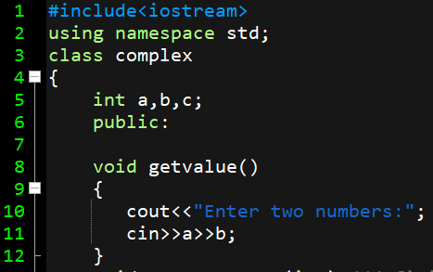
OVERLOADING UNARY OPERATOR
CLASS
Figure 5.22 Program made on Dev C++
Notes:
#include<iostream>
using namespace std;
class complex
{
int a,b,c;
public:
void getvalue()
{
cout<<"Enter two numbers:";
cin>>a>>b;
}
void operator ++ (int) //defining ‘Operator Function ++’
{
a= a++;
b= b++;
}
void operator--() //defining ‘Operator Function --
{
a= --a;
b= --b;
}
void display()
{
cout<<a<<"+"<<b<<"i";
cout<<endl;
}
}; //end of class complex
int main()
{
complex c1;
c1.getvalue();
c1.operator ++(0);
cout<<"Incremented complex number is:\n";
c1.display();
--c1;
cout<<"decremented complex number is:\n";
c1.display();
return 0;
}

Slide 13
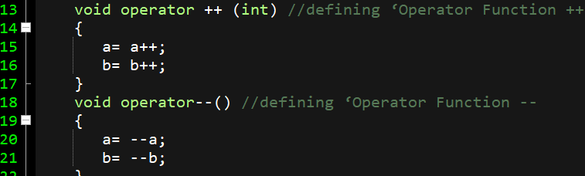
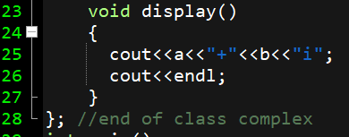
OVERLOADING UNARY OPERATOR
CLASS
Figure 5.23 Program made on Dev-C++
Notes:
#include<iostream>
using namespace std;
class complex
{
int a,b,c;
public:
void getvalue()
{
cout<<"Enter two numbers:";
cin>>a>>b;
}
void operator ++ (int) //defining ‘Operator Function ++’
{
a= a++;
b= b++;
}
void operator--() //defining ‘Operator Function --
{
a= --a;
b= --b;
}
void display()
{
cout<<a<<"+"<<b<<"i";
cout<<endl;
}
}; //end of class complex
int main()
{
complex c1;
c1.getvalue();
c1.operator ++(0);
cout<<"Incremented complex number is:\n";
c1.display();
--c1;
cout<<"decremented complex number is:\n";
c1.display();
return 0;
}

Slide 14
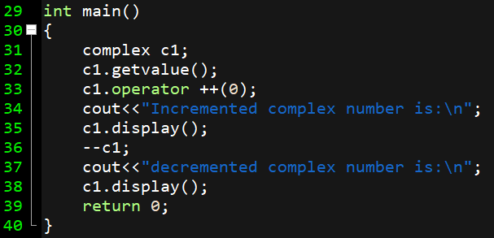
OVERLOADING UNARY OPERATOR
CLASS
Figure 4.24 Program made on Dev-C++
Notes:
#include<iostream>
using namespace std;
class complex
{
int a,b,c;
public:
void getvalue()
{
cout<<"Enter two numbers:";
cin>>a>>b;
}
void operator ++ (int) //defining ‘Operator Function ++’
{
a= a++;
b= b++;
}
void operator--() //defining ‘Operator Function --
{
a= --a;
b= --b;
}
void display()
{
cout<<a<<"+"<<b<<"i";
cout<<endl;
}
}; //end of class complex
int main()
{
complex c1;
c1.getvalue();
c1.operator ++(0);
cout<<"Incremented complex number is:\n";
c1.display();
--c1;
cout<<"decremented complex number is:\n";
c1.display();
return 0;
}

Slide 15
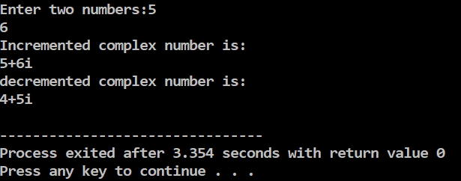
OUTPUT
CLASS
Figure 5.25 Program OUTPUT made on Dev-C++
Notes:
#include<iostream>
using namespace std;
class complex
{
int a,b,c;
public:
void getvalue()
{
cout<<"Enter two numbers:";
cin>>a>>b;
}
void operator ++ (int) //defining ‘Operator Function ++’
{
a= a++;
b= b++;
}
void operator--() //defining ‘Operator Function --
{
a= --a;
b= --b;
}
void display()
{
cout<<a<<"+"<<b<<"i";
cout<<endl;
}
}; //end of class complex
int main()
{
complex c1;
c1.getvalue();
c1.operator ++(0);
cout<<"Incremented complex number is:\n";
c1.display();
--c1;
cout<<"decremented complex number is:\n";
c1.display();
return 0;
}

Slide 16
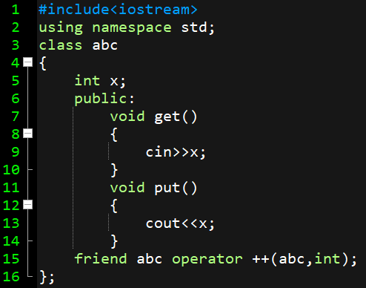
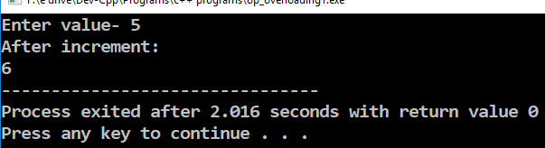
OVERLOADING POST INCREMENT USING FRIEND FUNCTION
CLASS
Figure 5.26 Program OUTPUT made on Dev-C++
Notes:
#include<iostream>
using namespace std;
class abc
{
int x;
public:
void get()
{
cin>>x;
}
void put()
{
cout<<x;
}
friend abc operator ++(abc,int);
};
abc operator ++(abc obj,int a)
{
abc temp;
temp.x=obj.x++;
return temp;
}
int main()
{
abc a1,a2;
a1.get();
a2=a1++;
cout<<"After increment:\n";
a2.put();
return 0;
}

Slide 17
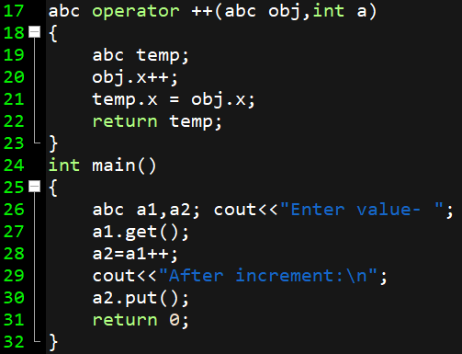
OVERLOADING POST INCREMENT USING FRIEND FUNCTION
CLASS
Figure 5.27 Program OUTPUT made on Dev-C++
Notes:
#include<iostream>
using namespace std;
class abc
{
int x;
public:
void get()
{
cin>>x;
}
void put()
{
cout<<x;
}
friend abc operator ++(abc,int);
};
abc operator ++(abc obj,int a)
{
abc temp;
temp.x=obj.x++;
return temp;
}
int main()
{
abc a1,a2;
a1.get();
a2=a1++;
cout<<"After increment:\n";
a2.put();
return 0;
}

Slide 18
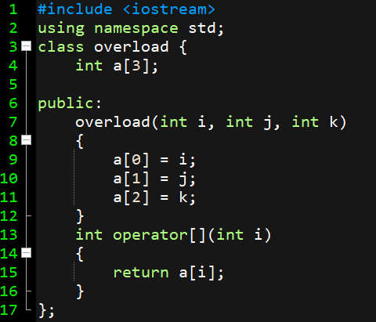
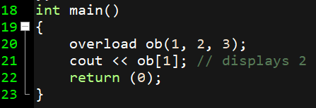
OVERLOADING [ ] OPERATOR
CLASS
Figure 5.28 Program OUTPUT made on Dev-C++
Notes:
#include <iostream>
using namespace std;
class overload {
int a[3];
public:
overload(int i, int j, int k)
{
a[0] = i;
a[1] = j;
a[2] = k;
}
int operator[](int i)
{
return a[i];
}
};
int main()
{
overload ob(1, 2, 3);
cout << ob[1]; // displays 2
return (0);
}

Slide 19
OVERLOADING BINARY OPERATOR
SYNTAX:
class_name operator op (class_name object)
Example:
complex operator + (complex ob) //operator function
{
// function body
}

Slide 20
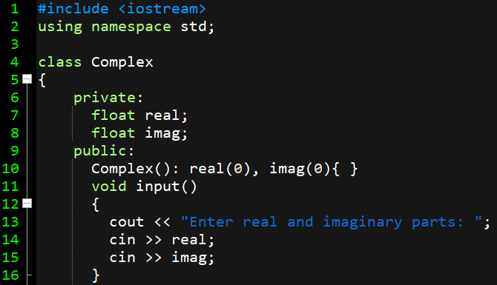
OVERLOADING BINARY OPERATOR
SYNTAX:
class_name operator op (class_name object)
Example:
complex operator + (complex ob) //operator function
{
// function body
}
Figure 5.29 Program made on Dev-C++

Slide 21
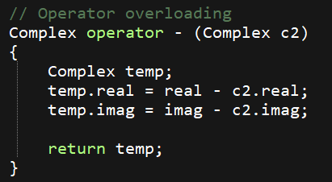
OVERLOADING BINARY OPERATOR
SYNTAX:
class_name operator op (class_name object)
Example:
complex operator + (complex ob) //operator function
{
// function body
}
Figure 5.30 Program made on Dev-C++
Notes:
#include <iostream>
using namespace std;
class Complex
{
private:
float real;
float imag;
public:
Complex(): real(0), imag(0){ }
void input()
{
cout << "Enter real and imaginary parts: ";
cin >> real;
cin >> imag;
}
// Operator overloading
Complex operator - (Complex c2)
{
Complex temp;
temp.real = real - c2.real;
temp.imag = imag - c2.imag;
return temp;
}
void output()
{
if(imag < 0)
cout << "Output Complex number: "<< real << imag << "i";
else
cout << "Output Complex number: " << real << "+" << imag << "i";
}
};//end of class
int main()
{
Complex c1, c2, result;
cout<<"Enter first complex number:\n";
c1.input();
cout<<"Enter second complex number:\n";
c2.input();
result = c1 - c2;
result.output();
return 0;
}

Slide 22
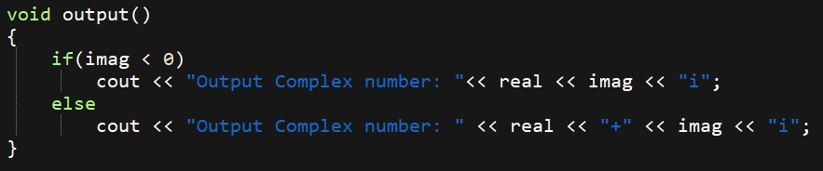
OVERLOADING BINARY OPERATOR
SYNTAX:
class_name operator op (class_name object)
Example:
complex operator + (complex ob) //operator function
{
// function body
}
Figure 5.31 Program made on Dev-C++
Notes:
#include <iostream>
using namespace std;
class Complex
{
private:
float real;
float imag;
public:
Complex(): real(0), imag(0){ }
void input()
{
cout << "Enter real and imaginary parts: ";
cin >> real;
cin >> imag;
}
// Operator overloading
Complex operator - (Complex c2)
{
Complex temp;
temp.real = real - c2.real;
temp.imag = imag - c2.imag;
return temp;
}
void output()
{
if(imag < 0)
cout << "Output Complex number: "<< real << imag << "i";
else
cout << "Output Complex number: " << real << "+" << imag << "i";
}
};//end of class
int main()
{
Complex c1, c2, result;
cout<<"Enter first complex number:\n";
c1.input();
cout<<"Enter second complex number:\n";
c2.input();
result = c1 - c2;
result.output();
return 0;
}

Slide 23
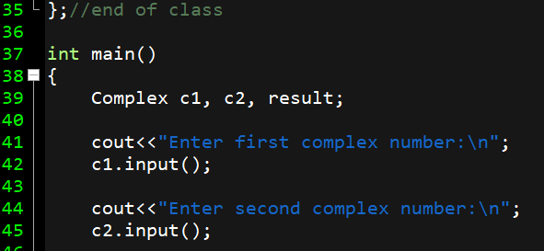
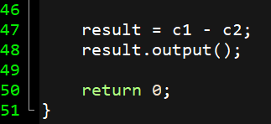
OVERLOADING BINARY OPERATOR
Figure 5.32 Program made on Dev-C++

Slide 24
Summary
In this lecture we have discussed about Operator overloading
We have discussed about Rules for overloading operators.
Discussed about types of operator that can be overloaded or not
Discussed about unary and binary overloading.

Slide 25
Frequently Asked question
Q1 What is a Operator overloading?
Operator overloading is used to overload or redefines most of the operators available in C++. It is used to perform the operation on the user-defined data type. For example, C++ provides the ability to add the variables of the user-defined data type that is applied to the built-in data types.
Q2 What is difference between operator overloading and functional overloading?
Operator overloading allows operators to have an extended meaning beyond their predefined operational meaning. Function overloading (method overloading) allows us to define a method in such a way that there are multiple ways to call it.

Slide 26
Q3 What are the rules for overloading operators?
There are some rules for the operator overloading. These rules are like below
Only built-in operators can be overloaded. If some operators are not present in C++, we cannot overload them.
The arity of the operators cannot be changed
The precedence of the operators remains same.
The overloaded operator cannot hold the default parameters except function call operator “()”.
We cannot overload operators for built-in data types. At least one user defined data types must be there.
The assignment “=”, subscript “[]”, function call “()” and arrow operator “->” these operators must be defined as member functions, not the friend functions.
Some operators like assignment “=”, address “&” and comma “,” are by default overloaded.

Slide 27
Assessment Questions:
1. What is operator overloading in C++? a) Overriding the operator meaning by the user defined meaning for user defined data type b) Redefining the way operator works for user defined types c) Ability to provide the operators with some special meaning for user defined data type d) All of the mentioned
2. What is the syntax of overloading operator + for class A? a) A operator+(argument_list){} b) A operator[+](argument_list){} c) int +(argument_list){} d) int [+](argument_list){}

Slide 28
Discussion forum.
Can we overload the operators using a Friend Function? If Yes then specify How?
https://www.youtube.com/watch?v=PoD10qspKrM

Slide 29

REFERENCES
Reference Books
[1] Programming in C++ by Reema Thareja.
[2] Programming in ANSI C++ by E. Balaguruswamy, Tata McGraw Hill.
[3] Programming with C++ (Schaum's Outline Series) by Byron Gottfried Jitender Chhabra, Tata McGraw Hill.
Websites:
https://www.geeksforgeeks.org/operator-overloading-c/
https://www.programiz.com/cpp-programming/operator-overloading
YouTube Links:
https://www.youtube.com/watch?v=BO2KagRMS3M

Slide 30
THANK YOU

